Slide 1
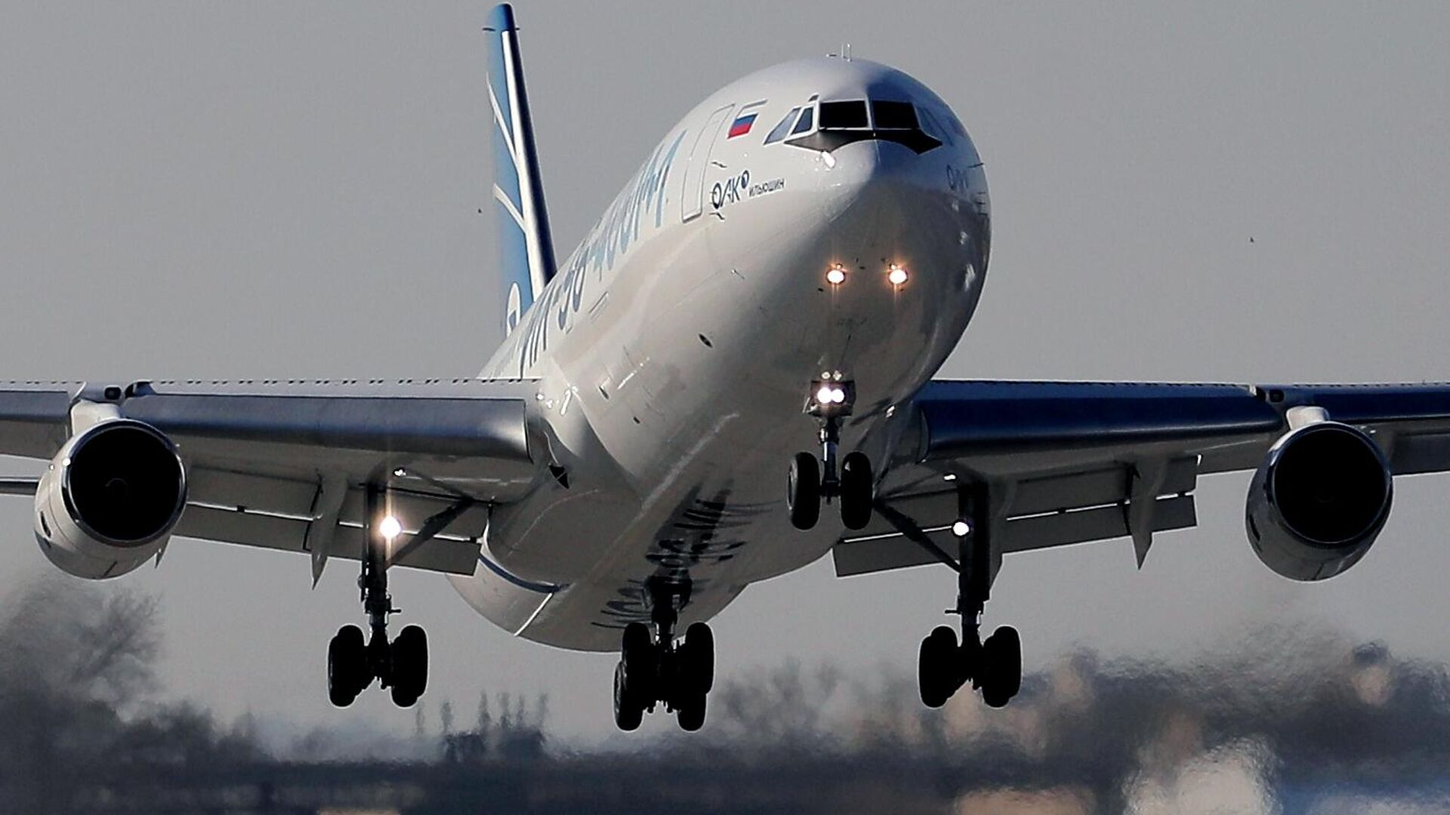
FLIGHT DELAY PREDICTION
Dharanibalan R
Dinesh Kumar S
Gowtham A
Kirran S T

Slide 2
Problem Statement:
Flight delays are a common issue in the aviation industry, leading to passenger dissatisfaction, operational inefficiencies, and financial losses. Predicting whether a flight will be delayed using historical flight data can help airlines and passengers make informed decisions. The challenge is to develop a machine learning model that accurately predicts flight delays based on features such as departure time, airline, origin, destination, and distance.

Slide 3
Introduction:
This project predicts flight delays using historical flight data.
Key features include departure time, airline, airports, and flight distance.
Data was cleaned and categorical variables were encoded.
Machine learning models like Naïve Bayes and Random Forest were tested.
Random Forest performed the best in terms of accuracy.
The model predicts if a flight will be delayed based on input data.
Future versions can include real-time weather and airport traffic info.

Slide 4
Objective of the Project:
To collect and understand past flight data, including details like departure time, airline, origin, destination, and distance.
To clean the data by fixing missing values and converting text data into numbers for machine learning.
To study the data and find the main reasons behind flight delays.
To use different machine learning models to predict flight delays.
To test and compare how well each model works.
To build a simple system that can predict if a flight will be delayed using the given details.

Slide 5
System Model:
1. Data Collection Collect past flight data including time, carrier, route, and delay information.
2. Data Preprocessing Clean the data, handle missing values, and convert text to numbers.
3. Feature Selection Select key features like time, airline, origin, destination, and distance.
4. Model Training Train Naïve Bayes and Random Forest models on the processed data.
5. Model Testing Test the models to check their accuracy.
6. Prediction Use the best-performing model to predict flight delays.
7. Result Display Display the prediction result clearly to the user.

Slide 6
Proposed Methodology:
Naïve Bayes (GaussianNB) Naïve Bayes is a simple model that uses probabilities to make predictions. It assumes all features are independent and uses inputs like departure time, airline, and distance to predict delays.
Random Forest Classifier Random Forest builds many decision trees and combines their results. It works well with both numbers and categories and gives better accuracy.

Slide 7
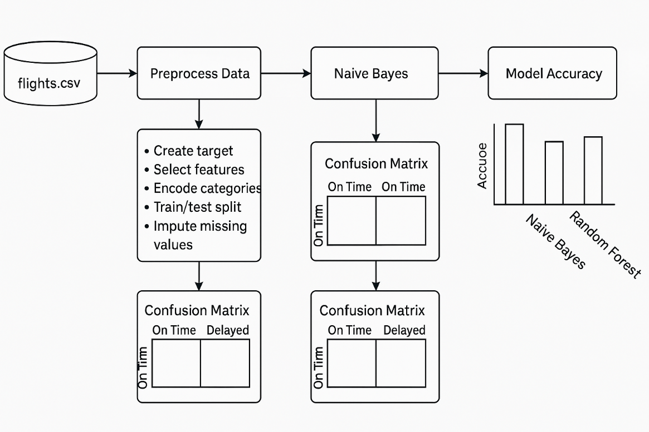
Architecture:
📂 The pipeline starts with flights.csv as the input dataset.
🔧 Data is preprocessed by creating targets, selecting features, encoding, splitting, and imputing.
🤖 Two models, Naive Bayes and Random Forest, are trained on the data.
📉 Confusion matrices are used to evaluate each model’s predictions.
📊 A bar chart compares the accuracy of the models

Slide 8
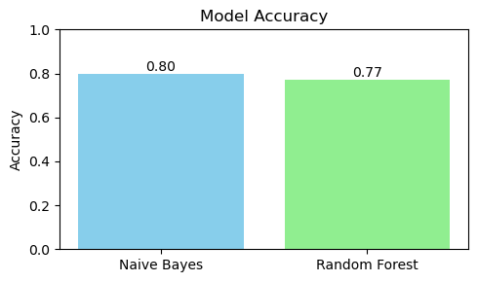
Comparison of Models:

Slide 9
Conclusion:
In this project, we built a machine learning system to predict flight delays using past flight data. We used two models—Naïve Bayes and Random Forest—and compared their accuracy.
The Random Forest model gave the best results and handled different types of data well. It was also less likely to overfit.
This project shows how machine learning can help in aviation. Early delay predictions can help airlines and passengers plan better, save time, and improve the travel experience.

Slide 10
Future Scope:
Add Live Data: Use real-time weather, traffic, and airport info to improve accuracy.
More Flight Details: Include things like actual vs. planned times and number of stops.
Use Better Models: Try advanced methods like XGBoost or deep learning.
Make an App or Website: Let users check delay predictions easily.
Customize for Regions or Airlines: Build models for specific places or airlines for better results.
Show Delay Times: Predict how long the delay might be, not just yes or no.
Explain Predictions: Show why a flight is delayed to help users understand and trust the system.

Slide 11


